Slide 1
DATA MODELLING, MANAGEMENT AND GOVERNANCE CIS108-6
Lecture 2: Software System Design Methods UML
2.1 Use Cases Modelling and Use Case Diagrams
Gangmin Li

Slide 2
What have we learnt?
What is a system?
System development Life Cycle
System development strategies
System development models
(RAD and Agile)
We practiced (continue) SQL

Slide 3
Agenda
General Software Development Tools
The Unified Modelling Language (UML)
System requirments determination
Use Case Modelling
Use Case Diagrams
Use Case Documentation

Slide 4
The Unified Modelling Language (UML)

Slide 5
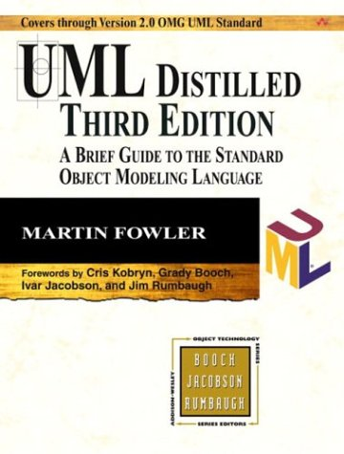
UML Main Literature
Martin Fowler
UML Distilled: a brief guide to
the standard object modeling
Language (3rd Edition)
Addison-Wesley, 2003
Available on BREO

Slide 6
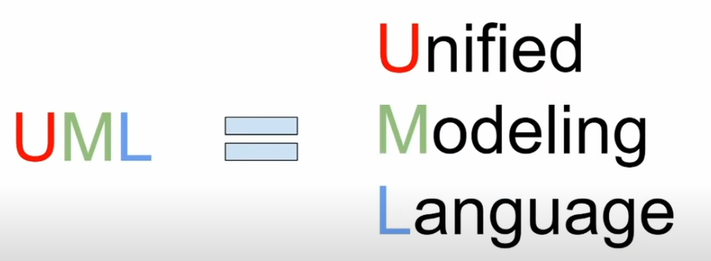
About UML
There are many ways to design a system. But if you want to communicate and exchange you design ideas you need UML
An integrated set of diagram of various agreed shapes and forms designed to help system and software developer to define design visualize and document software artifacts or business models

Slide 7
UML History
Open standard
1997: UML documentation 1.0
Controlled by the Object Management Group (OMG)
Unification of many object-oriented graphical modelling languages
The standard object modelling language

Slide 8
What is the UML?
UML is a set of best engineering practices in modelling large and complex systems
UML is a very important part of object-oriented software development
UML mainly uses graphical notation to express the software project's design
UML helps teams to communicate explore potential designs and validation
UML has been used to design for a wide range of applications including data systems and information systems

Slide 9
What is the UML?
Family of graphical notations
13 diagram styles (UML 2.0)
Structure, Behaviour and Interaction diagrams
Used to describe and design software systems
Particularly for object-oriented analysis
Emphasis on functionality rather than data alone (in contrast to entity-relationship models)

Slide 10
Using the UML (Mellor/Fowler)
UML as sketch
Informal, dynamic and somewhat incomplete
Forward engineering: first model, then write code (to communicate ideas)
Reverse engineering: Write code, then build UML diagram (to help understanding the code)
UML as blueprint
Detailed and complete design for a programmer to code
UML as programming language
UML compiled directly to executable code

Slide 11
UML Diagrams (in UML)
Diagram
Structure
Diagram
Behaviour
Diagram
Interaction
Diagram
Class
Diagram
Component
Diagram
Activity
Diagram
Sequence
Diagram
Composite
Stucture Diagr.
Deployment
Diagram
Use Case
Diagram
Communication
Diagram
Object
Diagram
Package
Diagram
State Machine
Diagram
Interaction
Overview Diagr.
Timing
Diagram

Slide 12
1. Use Case Modelling

Slide 13
Use Case Modelling
There are many ways to design a system, Use case modelling is one of the starting points:
Part of the requirements analysis
Technique to capture the functional requirements of a system
Describe the typical interactions between the user and the system
Precursor for other kinds of diagrams (like activity diagrams)

Slide 14
Use Case Modelling
Who are the initiator of the system and what the system can do for them?
Who are my users/actors and how are they related?
What can my users do?
Which functionality does my system offer?

Slide 15
Ways to Model Requirements
Like the system modelling, A variety of ways exist to model requirements:
Iconic / pictorial (diagrams)
Mathematical
Simulation
Narrative (Story, textual documentation)

Slide 16
Use Case Modelling in 4 Steps
Identify Actors
Identify Use Cases
Draw Use Case Diagram
Write Use Case Documentation

Slide 17
Themes
Basically there are two themes:
Actors
Use Cases

Slide 18
Actor/Role
Defines a role that user or any other subject plays when interacting with the system, uses the system in a different way
External to the system
May represent a human, but also an external system
Does not necessarily represent a specific physical entity
One physical entity can play the role of different actors

Slide 19
Identifying Actors
Ask
Who uses, installs, starts up, maintains, shuts down the system?
What other systems use this system?
Who provides and/or receives information from the system?

Slide 20
Example: Cash Dispenser
The functionality of an ATM is described as follows:
A card holder can withdraw money from the cash dispenser. To do so he/she has to authenticate to the system. Bank customers can consult their account balance and deposit money after authentication. The dispenser is refilled by a maintenance operator who also retrieves the money that has been deposited.
Identify and name the actors!

Slide 21
Actors in ATM
Card holder
Bank customers
Operator
What about dispenser?
Bank?

Slide 22
Use Cases
Describe the functionality provided to the actors by the system. They show how a system can be used
Which operations can be performed by which actors?
A Use Case should be a complete task from an actor’s perspective
A Use Case is a complete ‘processing’ unit

Slide 23
Identifying Use Cases
Analyse the text
How can actors use the system?
A card holder can withdraw money from the cash dispenser. To do so he/she has to authenticate to the system. Bank customers can consult their account balance and deposit money after authentication. The dispenser is refilled by a maintenance operator who also retrieves the money that has been deposited.

Slide 24
Actors in ATM
Card holder (withdraw money)
(authenticate)
Bank customers (consult balance)
(deposit money)
(authenticate)
Operator
(Maintenance)
(Refill)
(Retrieves money)

Slide 25
2. Use Case Diagrams

Slide 26
Use Case Diagrams
Graphical representation of use cases
Show actors, use cases and relationships between them
Also shows system boundaries
Which actors carry out which use cases
Which use cases include or extend other use cases
Relation between actors (Inheritance)

Slide 27

Basic components of UCD
Systems
Actors
User cases
Relationships
Association
Include
Extend
Generalisation

Slide 28
System and Boundary
A system is whatever you’re developing.
It could be a website, a software component, a business process, an app, or any number of other things.
Describes what’s internal and external to the system
Depicted by a rectangle and the system’s name
ATM

Slide 29
Actors
An actor is someone or something that uses our system to achieve a goal. That could be a person, an organization, another system, or an external device.
Actor
System Boundary
Actor
ATM
Bank
Customer
A primary actor initiates the use of the system (left)
A secondary actor is more reactionary. (right)

Slide 30
Use Case
A Use Case is depicted with this oval shape and it represents an action that accomplishes some sort of task within the system.
System Boundary
Actor
ATM
Simple but Sufficiently descriptive
Starts with a verb and reinforces an action
In a logical order when possible
Login
Check Balance
Customer
Transfer Funds
Make payment

Slide 31
Relationships
Association
Include
Extend
Generalisation / Inheritance

Slide 32
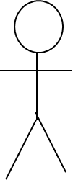
Association
An actor, by definition, is using our system to achieve a goal. So each actor has to interact with at least one of the Use Cases within our system.
ATM
Login
Bank
Check Balance
This type of relationship is called an association and it signifies a basic interaction. It is depicted with a solid line
Transfer Funds
Customer
Make payment

Slide 33
Include
An Include relationship shows dependency between a base use case and an included use case.
Every time the base use case is executed, the included use case is executed as well.
Another way to think of it is that the base use case requires an included use case in order to be complete.
Base Use Case
Include Use Case
<<include>>
Login
Verify Password
<<include>>

Slide 34
Extend
An Extend relationship shows relations between a base use case and an included use case.
When the base use case is executed, the extend use case will happen sometimes but not every time. The extend use case will only happen if certain criteria are met.
Another way to think of it is that you have the option to extend the behaviour of the base use case
Base Use Case
Extend Use Case
<<Extend>>
Display login Error
Login
<<Extend>>

Slide 35
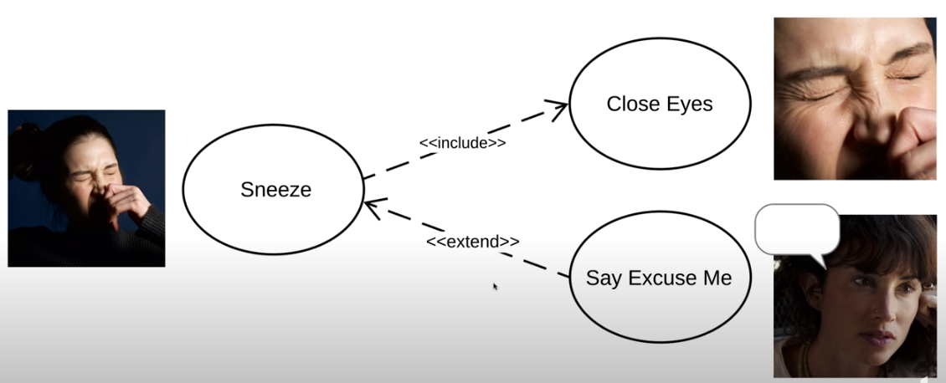
Examples
Verify Password
<<includes>>
Log in
<<extends>>
Display login Error

Slide 36
Example
ATM
Verify Password
Login
<<include>>
<<extend>>
Display Error
Check Balance
Verify Sufficient Funds
Bank
<<include>>
Customer
Transfer Funds
<<include>>
Make Payment

Slide 37
Include and Extend practical idea
Include happens every time, extend happens just sometimes,
The arrows point in opposite directions.
Multiple base use cases can point to the same included or extended use case.

Slide 38
Generalisation / Inheritance
In the Use Case diagram generalisation can be used between Actors or Use Cases
Inheritance is a‘kind-of’relationship
Generalisation between Use Cases
One Use Case is a specialised version of another Use Case
Generalisation between Actors
One Actor fulfils the same roles as another actor
An Actor interacts with the same Uses Cases in the same way (inherits them)
It may also fulfil specialised roles

Slide 39
Include Example
ATM
Verify Password
Login
<<include>>
<<extend>>
Display Error
Check Balance
Transfer Funds
Bank
Make Payment
Customer
Pay From Checking
Pay From Savings

Slide 40
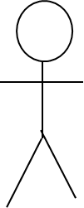
Generalisation Example
Create new
customer
Admin
Create credit
card customer
Create current
account customer
Senior Admin

Slide 41
Example: Cash Dispenser
The functionality of an ATM is described as follows:
A card holder can withdraw money from the cash dispenser. To do so he/she has to authenticate to the system. Bank customers can consult their account balance and deposit money after authentication. The dispenser is refilled by a maintenance operator who also retrieves the money that has been deposited.
Example for generalisation/inheritance?

Slide 42
Cash Dispenser UML Diagram
ATM
ne
Withdraw
money
<<include>>
Card
Holder
Authenticate
<<include>>
<<include>>
Consult
balance
Refill
Bank
Customer
Deposit
money
Retrieve
money
Maintenance
Operator

Slide 43
3. Use Case Documentation

Slide 44
Use Case Documentation
Textual description of use cases
Explain the dynamics of a use case in more detail
Each Use Case can include details such as:
Pre & Post Conditions
Flow of Events
Selection
Repetition
Error Conditions
Scenarios (alternative paths)

Slide 45
Use Case Documentation
Pre Condition(s)
Indicates what happens before a Use Case is activated
What state the Use Case must be in before processing
Post Condition(s)
The state of the Use Case after processing
Flow of events
A series of statements listing the steps of the Use Case from the user’s perspective

Slide 46
Use Case Documentation
Selection
When a choice has to be made
Shown by an ‘if’ statement
Repetition
This is used when a step must be repeated a number of times
Shown by a ‘while’ statement
Error Conditions
What happens when a user provides an incorrect input

Slide 47
Use Case Documentation
Scenarios (alternative paths)
A scenario is one path through the Use Case
Usually Use Cases have more than one scenario
Example:
A student arrives with correct qualifications
A student arrives without the correct qualification
A student fails a module

Slide 48
Example Use Case Documentation
Log On
Preconditions: User has obtained a membership number and password
User enters their membership number
User enters their password
System verifies membership number and password
System confirms that user is now logged on
Post-conditions: Member is logged on
Abnormal Paths:
If the Membership number/password are incorrect the system displays an error message

Slide 49
Example: Cash Dispenser
The functionality of an ATM is described as follows:
A card holder can withdraw money from the cash dispenser. To do so he/she has to authenticate to the system. Bank customers can consult their account balance and deposit money after authentication. The dispenser is refilled by a maintenance operator who also retrieves the money that has been deposited.
Example for pre/post conditions? Flow of events? Error handling and alternative scenarios?

Slide 50
Authenticate Use Case
Precondition
User has inserted a card
Postcondition
User is authenticated

Slide 51
Authenticate Use Case
Main flow of events (success sequence)
The ATM prompts the card holder for the PIN
Card holder inputs PIN
ATM verifies PIN
ATM requests authorisation from an authorisation system
Authorisation system confirms authorisation
The ATM authorises the card holder

Slide 52
Authenticate Use Case
Alternative Sequence
A1: 1st or 2nd time wrong PIN (starts at point 4 of main flow)
ATM informs card holder that the PIN is incorrect for the 1st or 2nd time
The scenario goes back to point 1

Slide 53
Authenticate Use Case
Error Sequence
E1: 3rd time wrong PIN (starts at point 4 of main flow)
ATM informs card holder that the PIN is incorrect for the 3rd time and that the card will be confiscated
ATM confiscates the card; the use case fails!

Slide 54
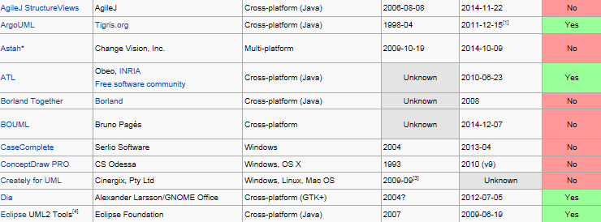
UML Support Software

Slide 55
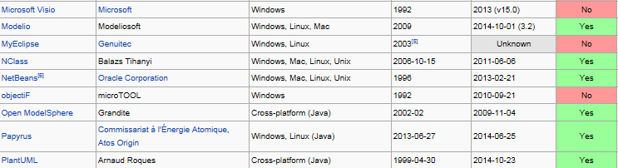
UML Support Software

Slide 56
Self-test
Website administration
Purpose: Website management or administration UML use case diagrams example.
Summary: Website Administrator actor could manage user groups, users, user sessions, and logs. Help Desk staff uses a subset of functions of manage users that is available to the Website Administrator to be able to assist customers having issues while using the customer-oriented website.

Slide 57
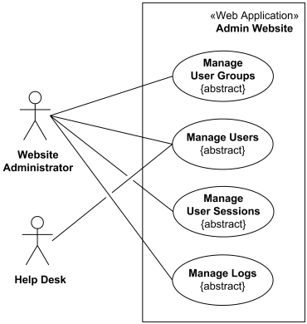
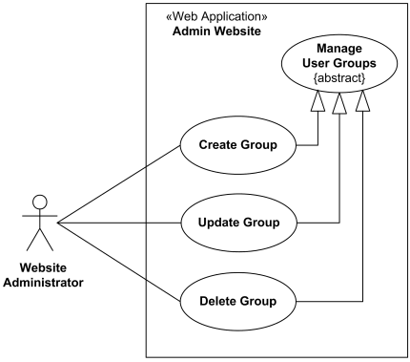
Self-test answer

Slide 58
Exercise 1
Given the following restaurant scenario,
Identify actors and use cases;
Draw a Use Case Diagram reflecting the scenario!
In a restaurant, a guest can order and then eat a meal. A waiter can take orders and deliver the bill. A guest can pay the bill either by credit card or cash. Credit card payment includes checking the credit card by a credit card company.

Slide 59
Restaurant Use Case Diagram
Restaurant
ne
Order
Meal
Bring Bill
Waiter
Eat Meal
Guest
Pay
Bill
Pay
Cash
<<include>>
Pay with
Credit Card
Check
Card
Credit Card
Company

